Slide 1
Group Role Assignment
Lab 1 | Qian Jiang
MUST | F.I.E
Notes:
Good Morning/Afternoon, My name is Jiang Qian. (Next slide)

Slide 2
Content
Preliminary Knowledge
Objectives
Assignment
Turn in Requirement
Notes:
This lab lesson is divided into five parts. First, we will introduce some preliminary knowledge about Group Role Assignment or the relevant programming information to solve this model. Next, we will talk about the objectives for this lesson. Then, we will talk about the assignment for this lesson and its requirement. (Next slide)

Slide 3
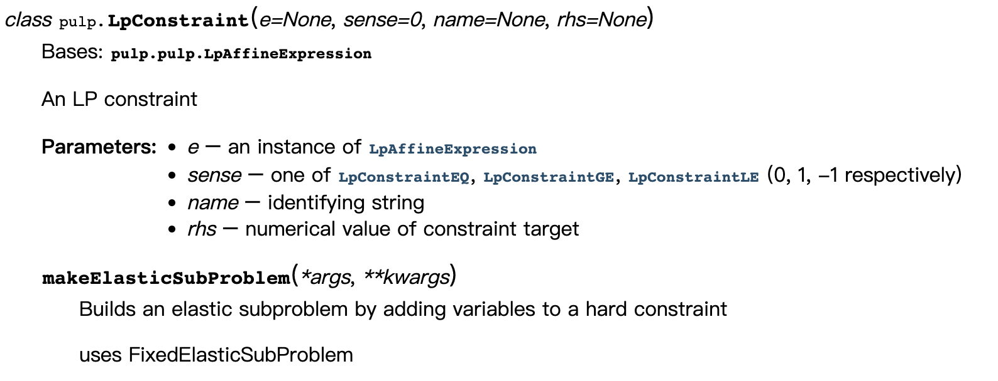
Preliminary Knowledge-PuLP Package
PuLP is an open-source linear programming (LP) package in Python. It provides tools for describing and solving linear and integer programs. PuLP can be used to model optimization problems as mathematical models, which can then be solved using various algorithms, or solvers.
One of the function explanations in the PuLP tutorial
The Python Package for Solving the GRA Model: PuLP Package
Notes:
First, we will talk about the programming language and relevant package for solving the GRA model. The programming language utilized in all the lab lesson is python. Based on this, we use the PuLP package for solving the GRA model because the GRA model is essentially an integer programming problem. PuLP is an open-source linear programming (LP) package in Python. It provides tools for describing and solving linear and integer programs. PuLP can be used to model optimization problems as mathematical models, which can then be solved using various algorithms, or solvers. PuLP’s main benefits are that it’s easy to install, easy to use, and its syntax closely resembles mathematical expressions. This makes the process of formulating your problem, implementing it in PuLP, and interpreting the results straightforward.

Slide 4
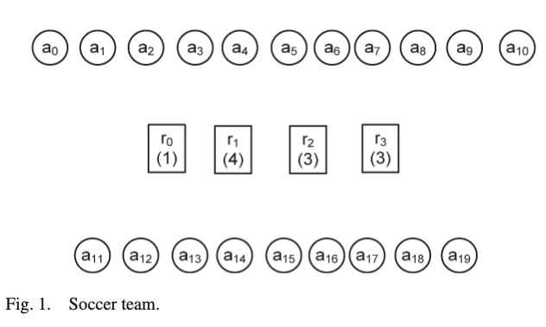
Preliminary Knowledge-A real-world Scenario
In a soccer team, 20 players in total (a₀-a₁₉).
In the field, four roles and 11 players (in total) for the 4-3-3 formation: one goalkeeper (r₀), four backs (r₁), three midfields (r₂), and three forwards (r₃).
Goal: Help a coach to choose the most suitable 11 players to be on the field.
A Real-world Scenario of the GRA Model: Constructing a Soccer Team
Notes:
To understand the problem of group role assignment, a scenario of a soccer team is considered. In a soccer team (Fig. 1), there are 20 players (a0–a19) in total. In the field, there are four roles and 11 players (in total) for the 4-3-3 formation: one goalkeeper (r0), four backs (r1), three midfields (r2), and three forwards (r3). Before each game, the most important task of the coach is to choose 11 players to be on the field.

Slide 5
Preliminary Knowledge-GRA Model
Group Role Assignment (GRA) is a submodel of the RBC methodology.
It is derived from the E-CARGO fundamental model.
It is an efficient tool to solve the 1-M (one-to-many) related problems.
∑ ::= <C, O, A, M, R, E, G, s₀, H>
Environments
Classes
Agents
Roles
Groups
Objects
Object-based
Agent-based
Role-based
The life cycling graph of RBC
Roles (Tasks): 4-3-3 Formation Agents (Executors): Candidate Players
Notes:
Group Role Assignment (GRA) is a submodel of the RBC methodology, and it is derived from the E-CARGO fundamental model. The mathematical expression of the GRA model is shown below. It is an efficient tool to solve the 1-M (one-to-many) related problems. A vital part of the GRA model is to identify the roles and the agents. As mentioned in the real-world scenario of the GRA model, the roles are the positions in the 4-3-3 formation, and the agents are the candidate players.

Slide 6
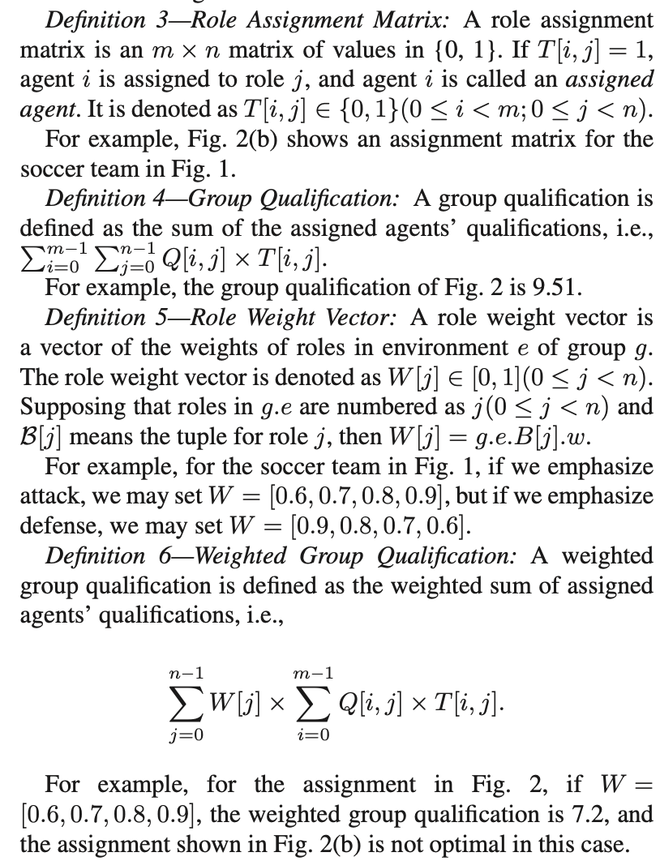
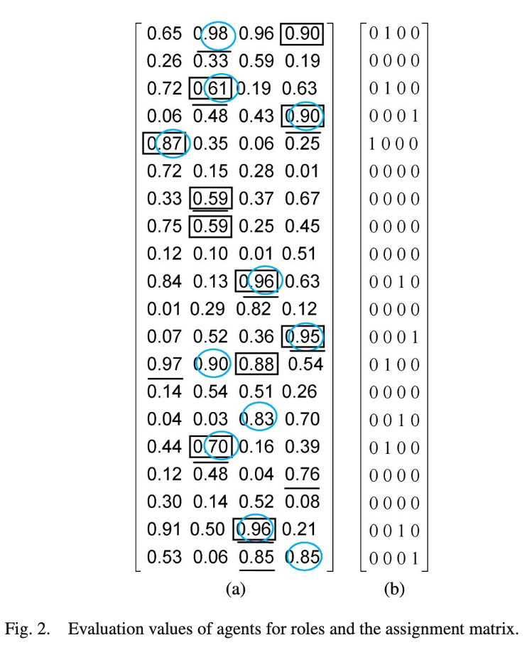
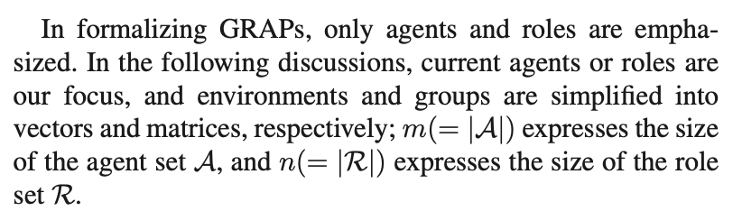
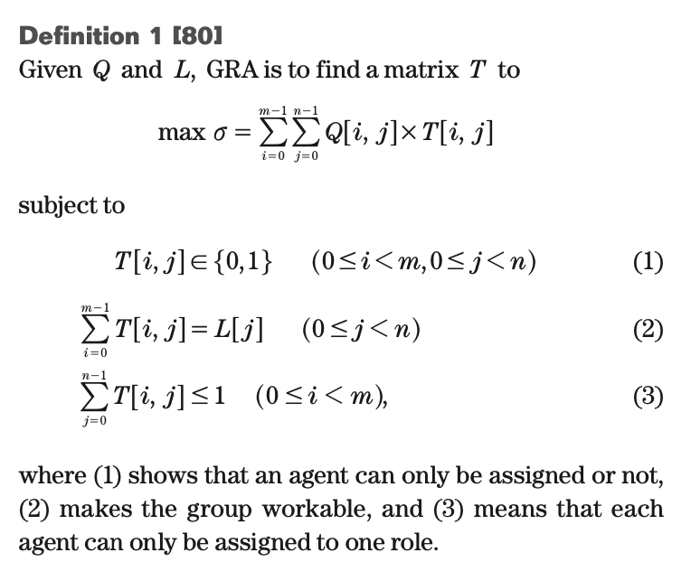
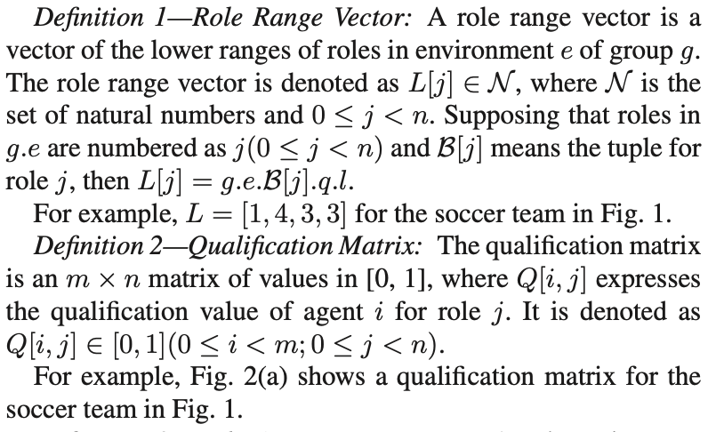
Preliminary Knowledge-GRA Model
∑ ::= <C, O, A, M, R, E, G, s₀, H>
Environments
Classes
Agents
Roles
Groups
Objects
Object-based
Agent-based
Role-based
Notes:
Next, we will talk about how to mathematically formalize the GRA model. First, we utilize symbols i and m to express the index of agents and the size of the agent set, respectively. Samely, we also use symbols j and n to express the index of roles and the size of the role set, respectively. Then, Definition 1 represents the role range vector L. The physical meaning of the symbol L is the required number of agents for the roles. That is [1, 4, 3, 3]. Definition 2 represents the qualification matrix, which is utilized to quantify the qualifications of agents to play roles. The values of the Q matrix are estimated by the coach in advance. Definition 3 represents the matrix of the control variables. It indicates the assignment result for the GRA model. Definitions 4 and 5 cooperatively constructs the objective functions for the GRA model. Based on above analysis, the mathematical expression of the GRA model is illustrated above.

Slide 7
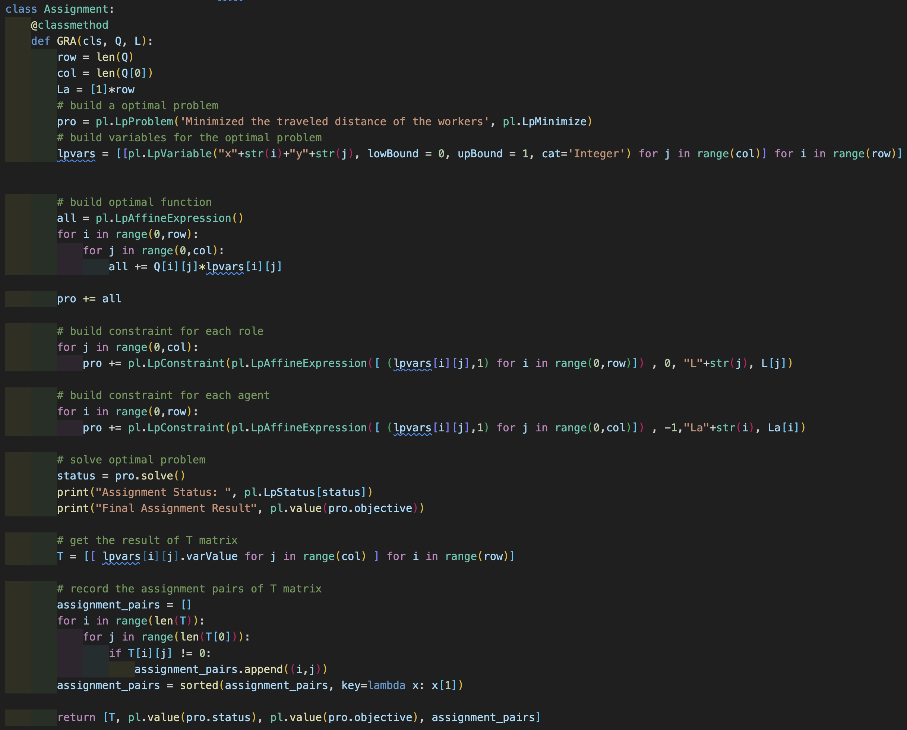
Preliminary Knowledge-Python Code Presentation

Slide 8
Content
Preliminary Knowledge
Objectives
Assignment
Turn in Requirement

Slide 9
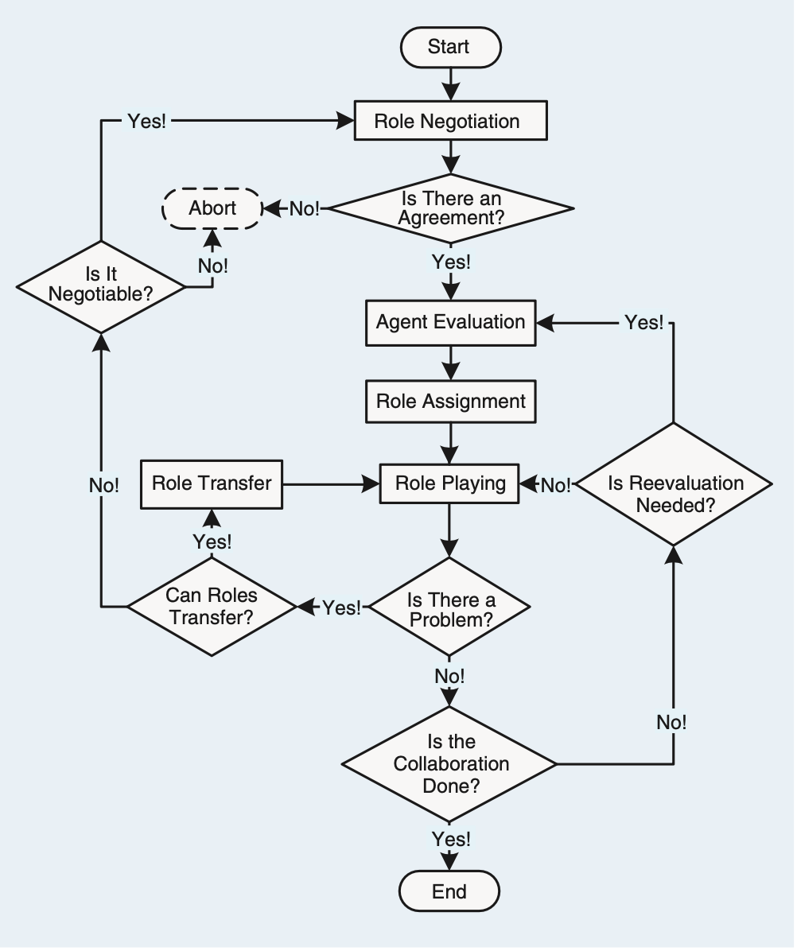
Objectives
The objectives of this course are two-fold:
1. To understand the process of RBC and learn about how to formalize problems with the GRA submodel;
2. To practice using Python to program the GRA model in order to solve the 1-M assignment problem.
Notes:
The objectives of this course are two-fold:
1. To understand the process of RBC and learn about how to formalize problems with the GRA submodel;
2. To practice using Python to program the GRA model in order to solve the 1-M assignment problem.

Slide 10
Content
Preliminary Knowledge
Objectives
Assignment
Turn in Requirement
Notes:
This lab lesson is divided into five parts. First, we will introduce some preliminary knowledge about Group Role Assignment or the relevant programming information to solve this model. Next, we will talk about the objectives for this lesson. Then, we will talk about the assignment for this lesson and its requirement. (Next slide)

Slide 11
Assignment
The assignment requirements for this lesson are as follows:
1. Suppose you are a manager of a company. Imagine and describe a scenario, i.e., to accomplish a complex task (RBC) by managing 30 agents (people, equipment, robots, groups of people, etc.).
2. You need to divide the complex into smaller subtasks (Roles). Be creative, and any simple method can be used.
3. You can choose from a list of candidates (Agents) to join the team to accomplish the task. Be creative, and any simple method can be used.
4. You need to determine a list of requirements for each task (role), i.e., role specification including L and other required properties. Be creative and reasonable. Any simple method can be used.

Slide 12
Assignment
5. Suppose that every agent should have a list of qualifications corresponding to the roles’ requirements. You create the evaluation of each agent for each subtask (role), i.e., the Q matrix. Be creative, and any simple method can be used.
6. After you obtain the Q matrix, use the GRA program (Group Role Assignment) to get the optimal assignment result, i.e., T.
7. Analyze whether the assignment is good or not from your own personal perspective. Argue why an optimized assignment result may not be the best choice.
8. Consider whether there are scalable aspects in this scenario (i.e., future works), as this is relevant to future lessons.
9. Encode and calculate assignment results using Python’s PuLP, and present the mathematical model and corresponding assignment results in the format of an IEEE paper.

Slide 13
Content
Preliminary Knowledge
Objectives
Assignment
Turn in Requirement
Notes:
This lab lesson is divided into five parts. First, we will introduce some preliminary knowledge about Group Role Assignment or the relevant programming information to solve this model. Next, we will talk about the objectives for this lesson. Then, we will talk about the assignment for this lesson and its requirement. (Next slide)

Slide 14
Turn in Requirement
1. A project report including the descriptions of your process details.
2. The report should be in the IEEE conference paper format, page limit = 2~3 pages. Refer to: https://www.ieee.org/conferences/publishing/templates.html, Choose Microsoft Word and US letter.
3. (*Vital) The paper to be submitted should include a depiction of plausible scenarios, modeling, and a reasonable interpretation of the experimental results. Furthermore, providing the source code, inclusive of the data, for the experiments could facilitate a more comprehensive evaluation.
Download the Relevant Materials:
https://github.com/jiangqian1997/E-CARGO-Codes/tree/main/Summber_School_Laboratory/Lab_1

